Slide 1
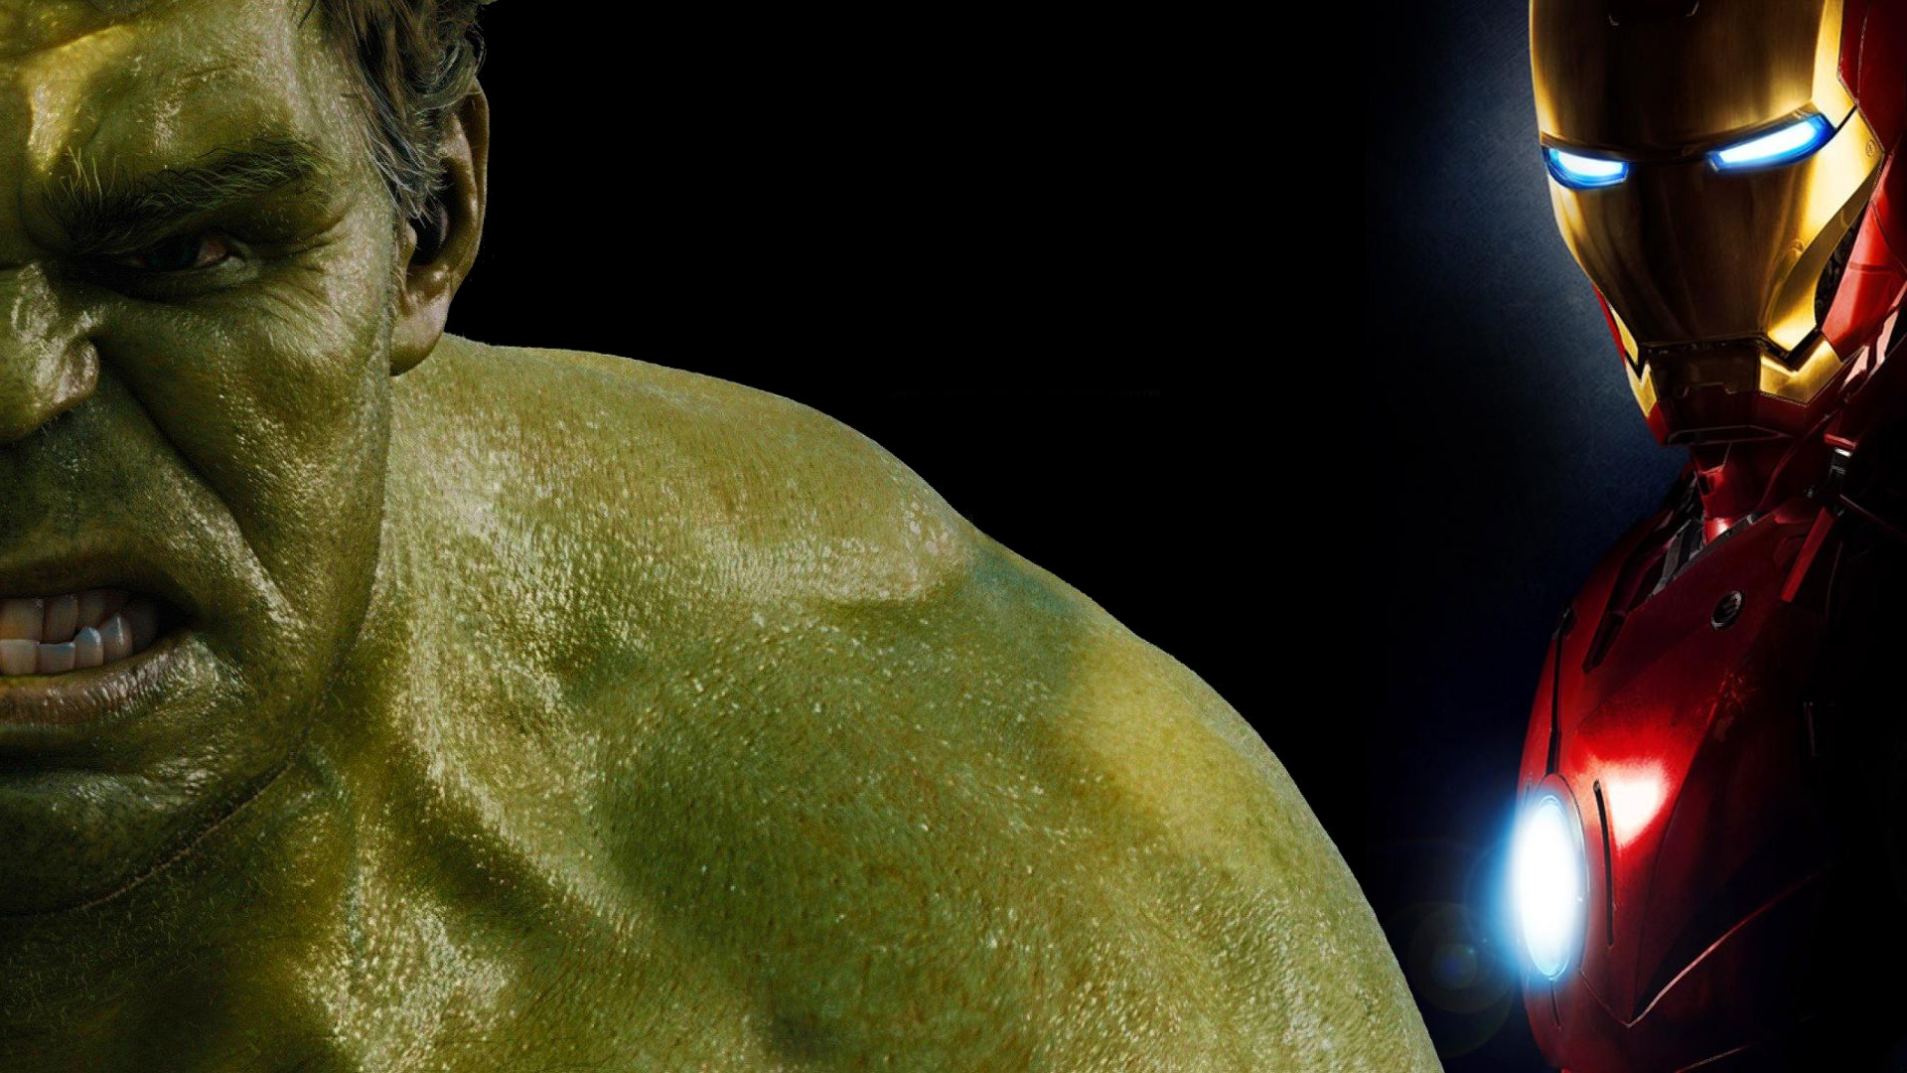

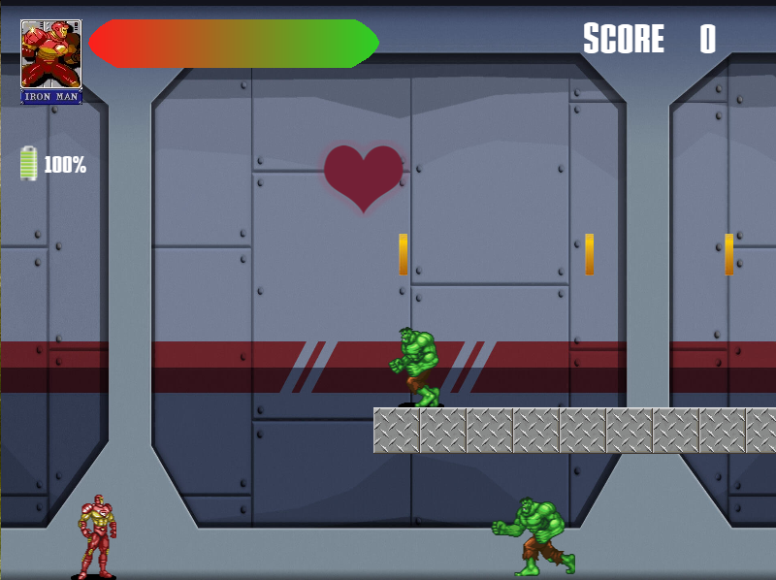
Iron man the clone attack
Kenny Rafael perroni molleton
REnATO LUIZ CARNEIRO JUNIOR

Slide 2
OVERVIEW
Iron Man
Hulk
Experiment
Clones
Idea!

Slide 3
Planning
Race?
Obstacles
Enemies
Side-scroller

Slide 4
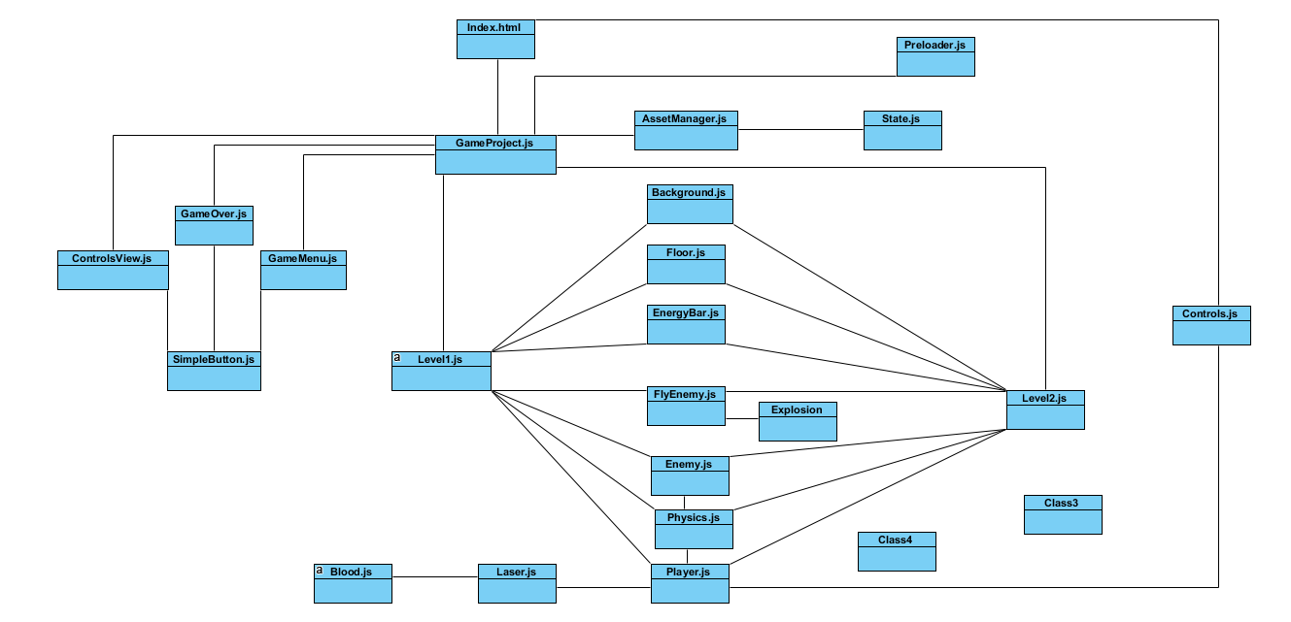

Slide 5
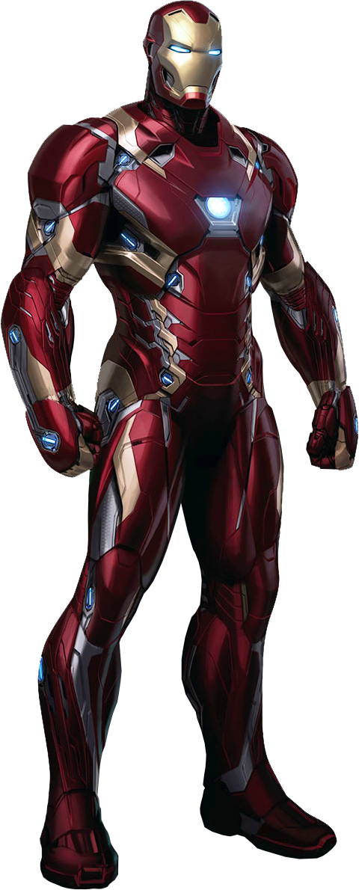
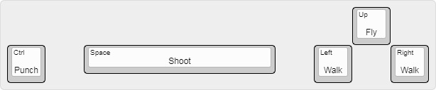
instructions

Slide 6
DEMO!

Slide 7
Lessons learned
How to start?
JSON Files
Resources (Sprites, images, sounds)

Slide 8
Future possibilities
Final Boss – War Machine/Dr. Doom
Power-ups – Unlimited Energy
Thugs – Enemies
New level - City

